Slide 1

Group 14
Krishna Surendra Palepu
Sasidhar Reddy Katikam
Naveen KUMAR NETTEM

Slide 2
Metaphor Detection using Transfer Learning

Slide 3

Statement of project Objectives
Achieve High Model Accuracy:
O Develop a metaphor prediction model with a focus on achieving high accuracy.
Metric: Accuracy
Optimize Classifier Precision:
Improve precision in metaphor prediction for individual classifiers (DNN, LSTM, Bi-LSTM).
Metric: Precision
Enhance Classifier Recall:
Increase recall to accurately identify a higher proportion of true positives.
Metric: Recall
Achieve Balanced Performance with F1 Score:
Attain a balanced performance by optimizing the F1 Score.
Metric: F1 Score
Comparative Analysis of Classifiers:
Compare the performance of DNN, LSTM, and Bi-LSTM classifiers.
Evaluation: Comparative analysis and qualitative examination.

Slide 4
Statement of Value : Capture nuanced layers of meaning in metaphorical language, surpassing literal interpretations.
1. Advanced Text Understanding:
Contribute to sophisticated text comprehension.
Enable systems to discern implicit meanings and nuances in metaphorical expressions.
Facilitate accurate and context-aware language processing.
2. Improved Human-Computer Interaction:
Elevate interaction by understanding the subtleties of metaphorical communication.
Enhance virtual assistants, chatbots, and natural language interfaces for greater user intuitiveness.
3. Enhanced Content Analysis:
Crucial for sentiment analysis, marketing, and social media monitoring.
Contribute to more nuanced content analysis, revealing hidden sentiments and trends.
4. Cultural and Contextual Sensitivity:
Foster cultural understanding in automated systems.
Mitigate the risk of misinterpretation, promoting culturally aware applications.
5. Educational Tools:
Develop tools aiding language learners in understanding figurative language.
Positive impact on language acquisition, especially for individuals learning a second language.

Slide 5
State of Art AND RELEVANT WORKS
Sl.No | Author’s name | Full title of paper with year | Inference from paper | Open problem
1 | Chuhan Wu , Fangzhao Wu , Yubo Chen, Sixing Wu , Zhigang Yuan, Yongfeng Huang | Neural Metaphor Detecting with CNN-LSTM Model(2018) | NLTK package for lemmatization,k-means for similar word embeddings,CNN to extract local contextual information,Bi-directional LSTM,CRF and softmax activation function | Making the existing model more efficient or making a new model with better efficiency.
2 | Krishnakant Swarnkar, Anil Kumar Singh | Di-LSTM Contrast : A Deep Neural Network for Metaphor Detection(2018) | Bi-directional LSTM for context encoding,TensorFlow library in Python2 for implementation, AdaGrad optimizer is used for optimization | experiment with CNNs along with LSTM. the use of attention mechanism
3 | Dongyu Zhang,Hongfei Lin ,Xikai Liu,Heting Zhang, Shaowu Zhang | Combining the Attention Network and Semantic Representation for Chinese Verb Metaphor Identification(2019) | Fused original word-vector with Synonym thesaurus(Synonyms2Vec). MetaATA-Parser model(verb metaphor attention networks model),based on SVO used to extract the subject-predicate structure in sentences automatically. | Making the existing model more efficient or making a new model with better efficiency.
4 | Vaibhav Kesarwani, Diana Inkpen, Stan Szpakowicz, Chris Tanasescu | Metaphor Detection in a Poetry Corpus(2017) | POS tag sequences,Annotating the Corpus,Rule-based Metaphor Detection, Statistical-based Metaphor Detection, CNN, | developing a metaphor not depending on any syntactical pattern and integrating the web application into a overall network graph analysis and visualization tool.

Slide 6
STATE OF ART AND Relevant works
Sl.No | Author’s name | Full title of paper with year | Inference from paper | Open problem
5 | Egon W. Stemle Alexander Onysko | Using Language Learner Data for Metaphor Detection(2018) | BiRNN with a LSTM architecture , Gensim a Python tool for unsupervised semantic modelling, Keras on top of TensorFlow,softmax as an activation function, fastText’s SkipGram model for training WE. | European Network for Combining Language Learning with Crowdsourcing Techniques.
6 | Rowan Hall Maudslay Tiago Pimentel Ryan Cotterell Simone Teufel | Metaphor Detection Using Context and Concreteness(2020) | BERT for Contextual Word Embedding, ReLU activation function,AdamW optimizer. | Explore first training a model to identify concreteness in context, then fine-tuning this to metaphor identification.
7 | Jerry Liu, Nathan O’Hara, Alexander Rubin, Rachel Draelos, Cynthia Rudin | Metaphor Detection Using Contextual Word Embeddings From Transformers(2020) | Propose using both BERT and XLNet language models to create contextualized embeddings and a bidirectional LSTM to identify whether a given word is a metaphor. | Making the existing model more efficient or making a new model with better efficiency.
8 | Zhilin Yang, Zihang Dai, Yiming Yang, Jaime Carbonell, Ruslan Salakhutdinov | XLNet: Generalized Autoregressive Pre-training for Language Understanding(2019) | propose XLNet, a generalized autoregressive pretraining method that integrates ideas from Transformer-XL, the state-of-the-art autoregressive model, into pretraining. It outperforms BERT on 20 tasks. | Making the existing model more efficient or making a new model with better efficiency.
9 | Yu Sun, Shuohuan Wang, Yukun Li, Shikun Feng, Hao Tian, Hua Wu, Haifeng Wang | ERNIE 2.0: A Continual Pre-Training Framework for Language Understanding(2019) | Proposed a continual pre-training framework named ERNIE 2.0 which incrementally builds pre-training tasks and then learn pre-trained models on these constructed tasks via continual multi-task learning. | Making the existing model more efficient or making a new model with better efficiency.

Slide 7
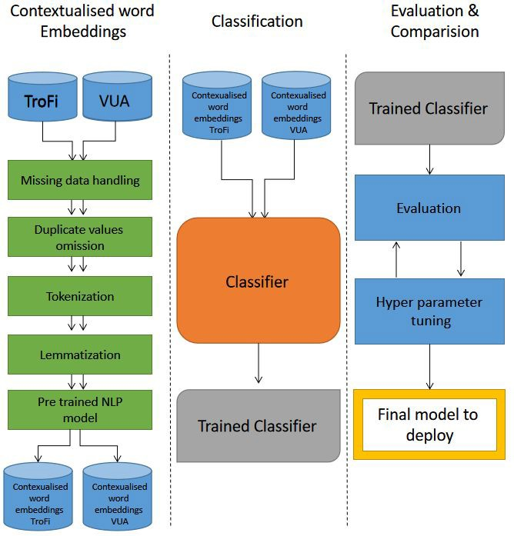
Approach

Slide 8
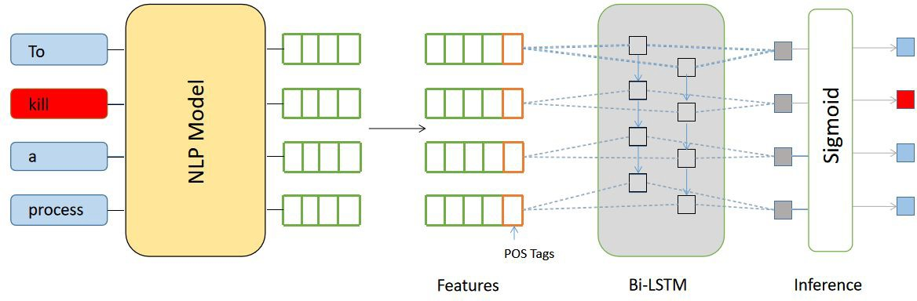
ARCHITECTURE DIAGRAM
Sentense

Slide 9
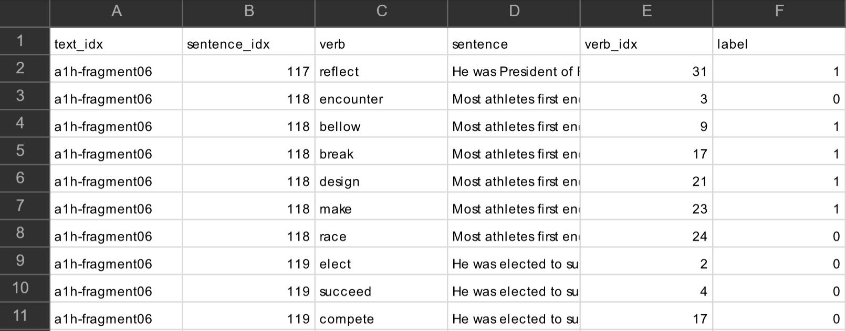
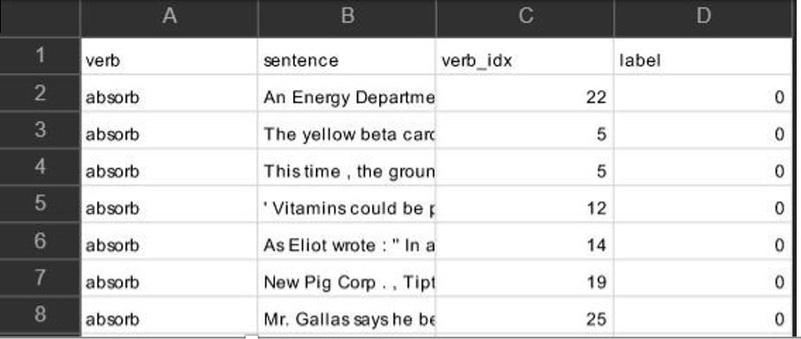
DATASET
VUA Dataset Size: 23114
Trofi Dataset Size:3738

Slide 10
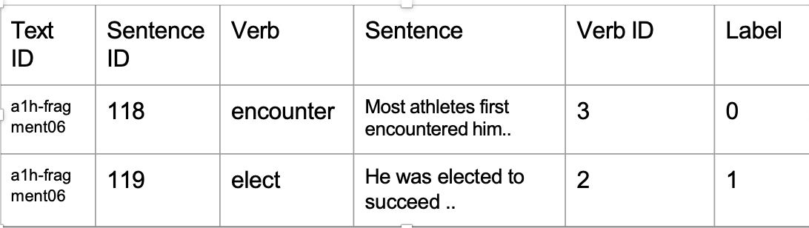
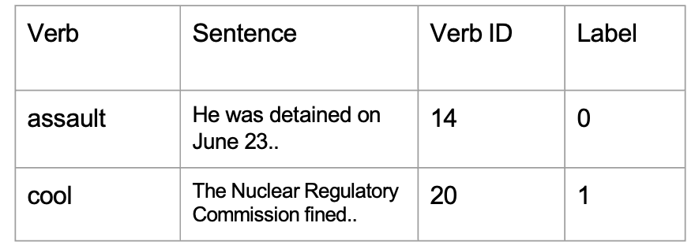
DATASET
VUA Dataset Size: 23114
Trofi Dataset Size:3738

Slide 11
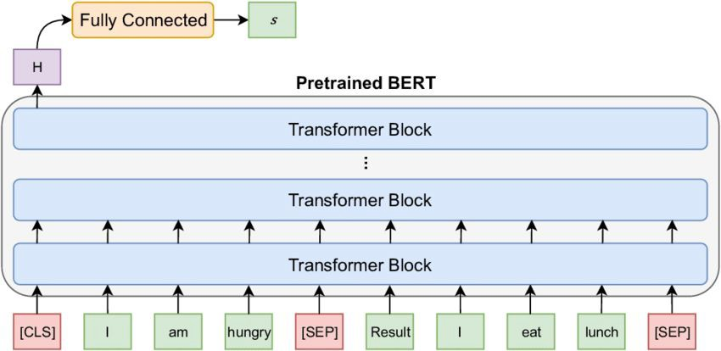
BERT
BERT makes use of Transformer, an attention mechanism that learns contextual relations between words (or sub-words) in a text.
Before feeding word sequences into BERT, 15% of the words in each sequence are replaced with a [CLS]/[SEP] token.
It is designed to pre-train deep bidirectional representations from unlabeled text by jointly conditioning on both left and right context. As a result, the pre-trained BERT model can be fine-tuned with just one additional output layer to create state-of-the-art models for a wide range of NLP tasks

Slide 12
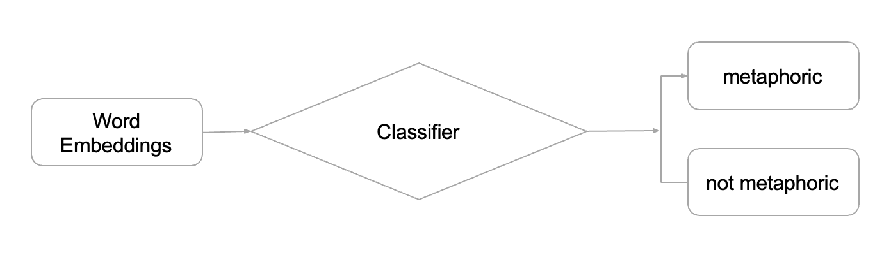
Classifiers
In machine learning, a classifier is an algorithm that automatically sorts or categorizes data into one or more classes. Here, its primary use will be to classify if the sentence is metaphoric or not. The following are some of the classifiers that have been used.

Slide 13
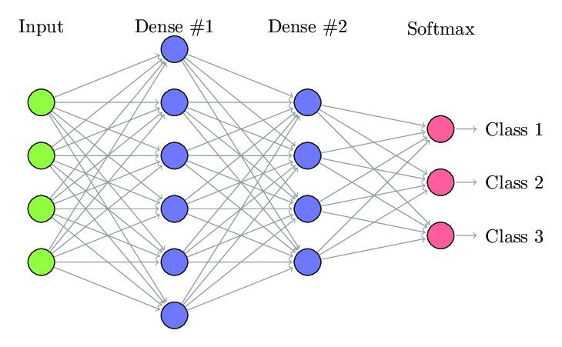
Dense Neural Network
A dense network is one in which each node's number of connections approaches the maximum number of nodes. Each node is connected to every other node. A fully wired network is one on which every node is connected to every other node in the same way.

Slide 14
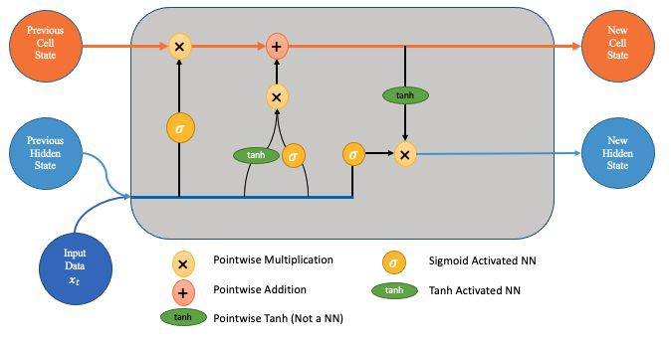
LSTM
Long short-term memory is an artificial recurrent neural network architecture. LSTM has feedback relations, unlike normal feed-forward neural networks. It can handle not just single data points, but also whole data sequences.

Slide 15
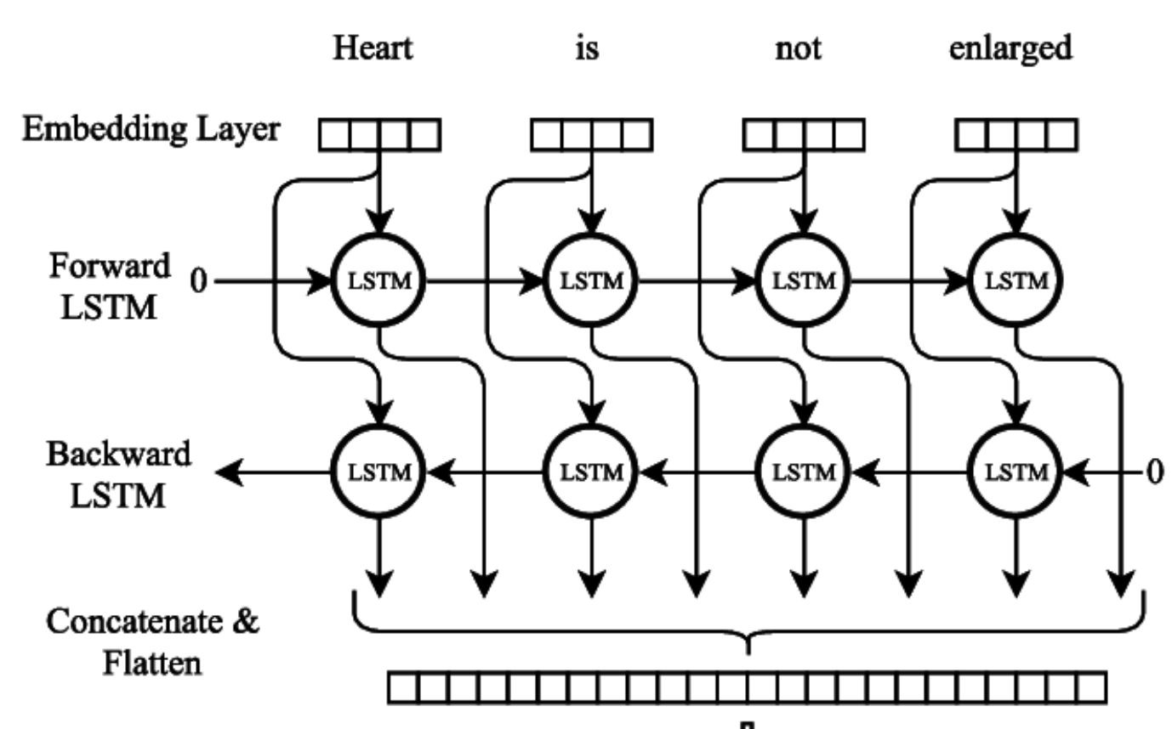
Bi-LSTM
Bidirectional LSTMs(Bi-LSTM) are a type of LSTM that can be used to increase model performance in sequence classification problems. Bidirectional LSTMs train two instead of one LSTM on the input sequence in problems where all timesteps of the input sequence are visible.

Slide 16
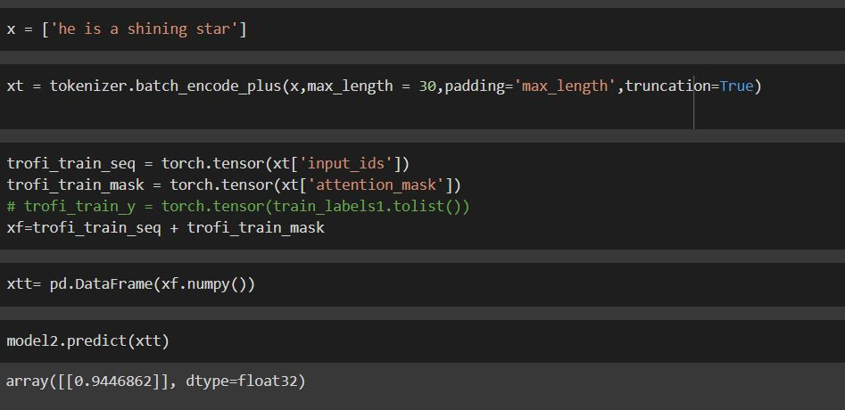
Sample Output

Slide 17
DELIVERABLEs
Performance Metrics Report
Report on classifier performance metrics.
User Documentation Manual
Manual for project understanding and usage instructions.
Code Repository
GitHub repository containing all project code.
Presentation Slides
Concise slides summarizing project findings..

Slide 18
Evaluation Methodology
Model Accuracy Assessment:
Metric: Accuracy
Evaluation: Measure the overall correctness of the model's metaphor predictions.
Classifier Precision Analysis:
Metric: Precision
Evaluation: Assess the proportion of true positives among predicted positives for each classifier (DNN, LSTM, Bi-LSTM).
Classifier Recall Examination:
Metric: Recall
Evaluation: Examine the proportion of true positives among actual positives for each classifier.
F1 Score Calculation:
Metric: F1 Score
Evaluation: Calculate the harmonic mean of precision and recall for a balanced assessment of classifier performance.

Slide 19
THANK YOU

